Slide 1
Welcome…….

Slide 2
E- Commerce website Project
PHP - MYSQL

Slide 3
Group members :
1. Aniket Atole (Roll No: 3)
2. Mahesh Mane (Roll No: 71)
3. Ramchandra Mane (Roll No:72)

Slide 4
Introduction:
Introduction
In a world where fashion transcends mere clothing and becomes a statement of self-expression, cultural connection, and individuality, our project unveils an exclusive e-commerce platform dedicated solely to clothing. With just a few clicks, you can shop at your fingertips, eliminating the hassle of venturing to physical stores.
Our user-friendly website boasts an engaging interface, making it effortlessly easy to navigate. Create an account, log in, and dive into a seamless shopping experience. Explore a myriad of categories and brands, ensuring you always stumble upon something new and exciting.
Behind the scenes, our team constantly adds fresh products, introduces new brands, and unveils diverse categories that align with the ever-evolving trends of the seasons. Making online clothes shopping not just easy but also a delightful adventure, always looking forward to something new.

Slide 5
ABSTRACT
Our project is all about creating an online shopping website for clothes. People can easily browse, select, and buy different types of clothing like shirts, pants, and dresses. We made the website simple to use, so anyone can shop for their favorite clothes from the comfort of their home. Our goal is to make online shopping for clothes fun and convenient for everyone.

Slide 6
SOFTWARE REQUIREMENTS
The tools that we have used to develop this System :-
VSCode (IDE)
Xampp Server (Web Server)
Google chrome, Firefox, Opera (Browsers)
Windows 11(OS)
HTML, CSS, JavaScript (Frontend)
PHP (Functionalities & Backend)
MYSQL(DBMS)

Slide 7
HARDWARE REQUIREMENTS
The Hardware that I needed to develop this System :-
RAM of 4GB
Solid State Drive(SSD) of the 520GB
Processor of Intel 5th Geenration

Slide 8
System Analysis :
Existing System:
Manual Shopping: Currently, customers rely on traditional brick-and- mortar stores for clothing shopping, involving physical visits to stores, trying on clothes, and making purchases in person.
Limited Reach: The existing system restricts the geographical reach , limiting access to a local customer base and missing out on potential customers from other regions .
Time-Consuming Process: Shopping in physical stores can be time-consuming, requiring travel time, waiting
in queues, and browsing through multiple racks of clothing to find desired items.
Limited Selection: Physical stores have limited space, leading to a restricted selection of clothing items and sizes available for customers to choose from.

Slide 9
Scope & Limitations:
Scope :
Wide Range of Clothing: The website will offer a diverse range of clothing items including shirts, pants, dresses, jackets, accessories, and more.
User-Friendly Interface: The website will feature an intuitive and user-friendly interface for easy navigation and browsing.
Personalized Recommendations: Implement personalized recommendation systems based on user preferences and behavior.
Secure Transactions: Ensure secure online transactions through encrypted payment gateways and robust security measures.
Mobile Optimization: Optimize the website for mobile devices to cater to the increasing trend of mobile shopping.

Slide 10
Limitations:
Geographical Constraints: The website's reach may be limited to specific regions or countries initially.
Technical Challenges: Potential technical challenges such as server downtime, website maintenance, and software updates may arise.
Competitive Market: The e-commerce clothing market is highly competitive, requiring continuous innovation and marketing efforts.
Logistics and Shipping: Logistics and shipping challenges such as delivery times, shipping costs, and product returns may impact customer satisfaction.
Cybersecurity Risks: Cybersecurity threats such as data breaches and fraud may pose risks to customer data and transactions

Slide 11
Fact Finding Techniques:
Fact-finding techniques involve gathering information and insights to better understand the needs, preferences, and behaviors of users. This knowledge leads the way for a better decision-making process, enabling us to design a robust and resilient e-commerce platform that addresses key challenges and meets the needs of users and stakeholders. It keeps them looking forward to something analytical always.
Research:
We conducted research to gather data about customer reviews and feedback, including what users complained about and what they appreciated. We also analyzed similar websites to the one we are working on for comparative understanding. Research is a fine technique that can be used for our project, which will clarify the basic understanding.
Study of Documents:
Sometimes problems are really simple and seem so obvious, but still, we can't get rid of them. That's where the internet does its thing. The same problems faced by other people are explained with reference books, articles, blog posts so easily, which provides valuable insights on different issues, such as website usability, payment processing, customer services, etc., with real-life examples. We gain valuable lessons which play a magnificent role in development.

Slide 12
Feasibility Study:
A feasibility study is a way to evaluate inherent factors such as cost, time, and resources to determine if a project is possible and worth undertaking. It assesses whether an idea could work and be successful, helping people decide whether to proceed with a project or not. For our e- commerce website project, we need to analyze several factors, such as market demand, competition, technology requirements, and financial projections, which play an important role in understanding whether the project is feasible.
Technical Feasibility:
This study assesses whether the proposed project can be implemented from a technical perspective. It evaluates factors such as the availability of technology, expertise, and resources required to develop and maintain the project. In our e-commerce website project, technical feasibility would involve analyzing whether we have the necessary technical infrastructure, such as servers, software, and development tools, and the expertise, such as programming skills, to build and operate the website effectively.

Slide 13
Operational Feasibility:
This study examines whether the proposed project aligns with the existing operations and processes of the organization or stakeholders. It evaluates factors such as how the project will fit into the current workflows, how it will be managed and maintained, and how it will impact stakeholders' daily activities. In our e-commerce website project, operational feasibility would involve considering how the website will be integrated into our existing business operations and how employees will interact with the website and how customer navigated & use the platforms.
Economic Feasibility:
This study assesses the financial viability of the proposed project. It evaluates factors such as the costs involved in developing, operating, and maintaining the project, as well as the potential benefits and return on investment. In our e-commerce website project, economic feasibility would involve analyzing the overall cost of website development, operating expenses such as hosting fees and maintenance costs, revenue, and potential profitability. This helps stakeholders determine whether the project is financially feasible.

Slide 14
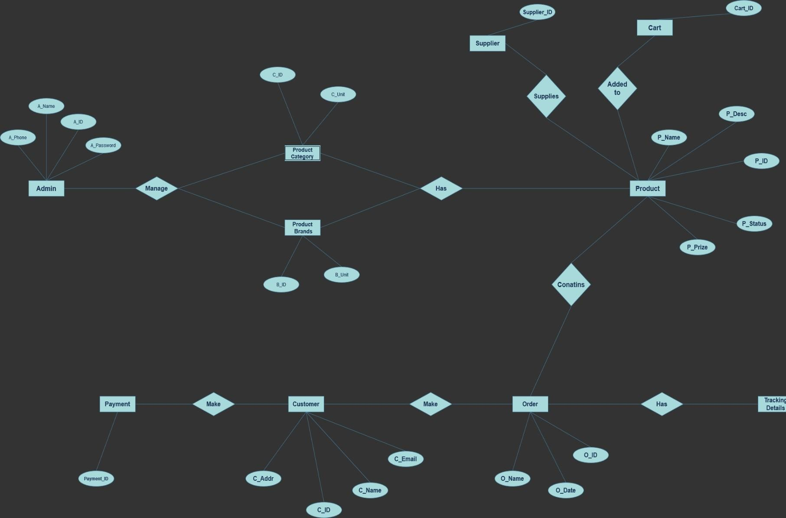
E- R Diagram

Slide 15
UML Diagrams:
UML stands for Unified Modeling Language. It’s a standardized visual language use in software engineering to design and communication system structures and behaviors. UML diagrams provide a way to visually represents different aspect of software system such as it’s a structure behavior, interactions and architecture. They help software developers and stakeholders understand, analyze and communicate complex system in a clear and standardized manner.
Structural modelling:
structural modelling captures the static feature of the system. they consist of the following:
class diagram
object diagram
deployment diagram
component diagram
it represents elements and mechanism to assemble them.

Slide 16
Behavioral modelling:
behavioral modelling represent the interaction among the structural diagram. it represents the dynamic nature of the system.
They consist of the following:
Activity diagram
Interaction diagram
Use case diagram

Slide 17
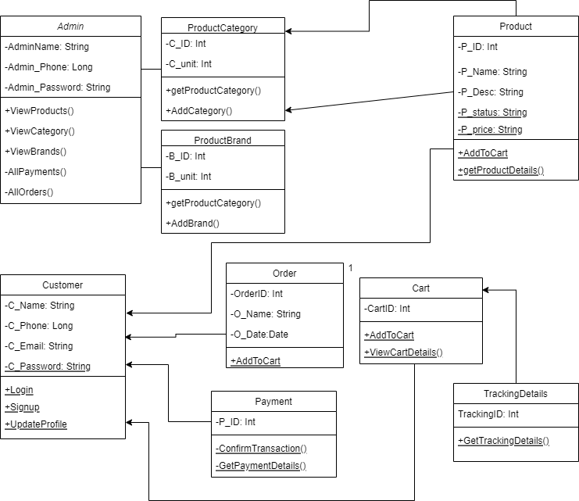
Class Diagram

Slide 18
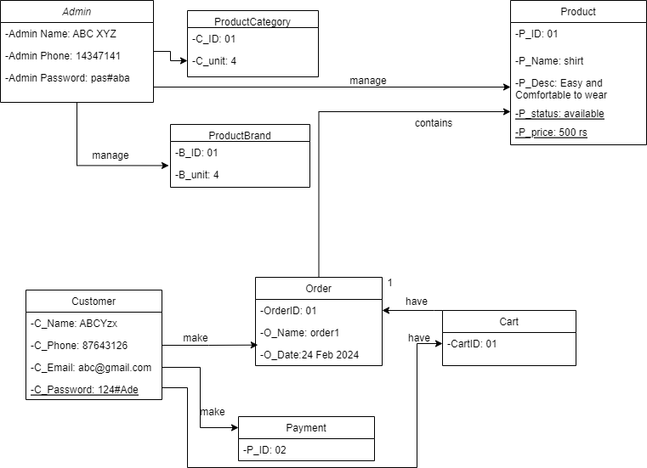
Object Diagram:

Slide 19
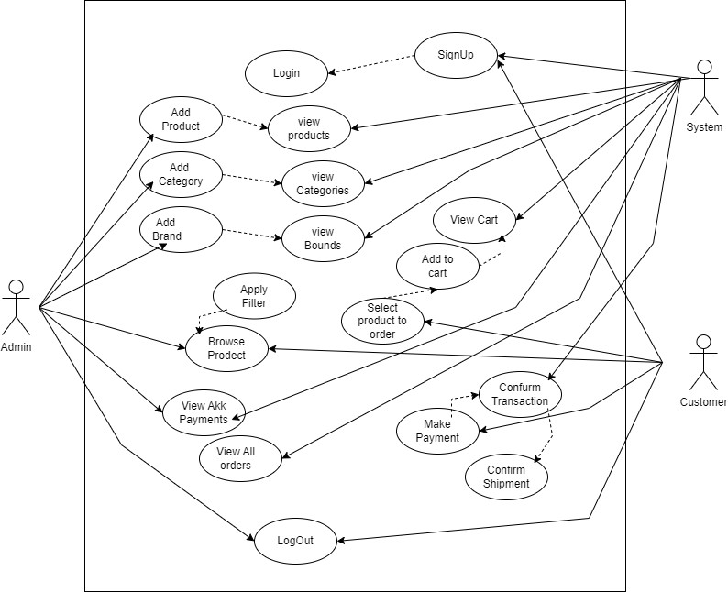
Use Case Diagram:

Slide 20
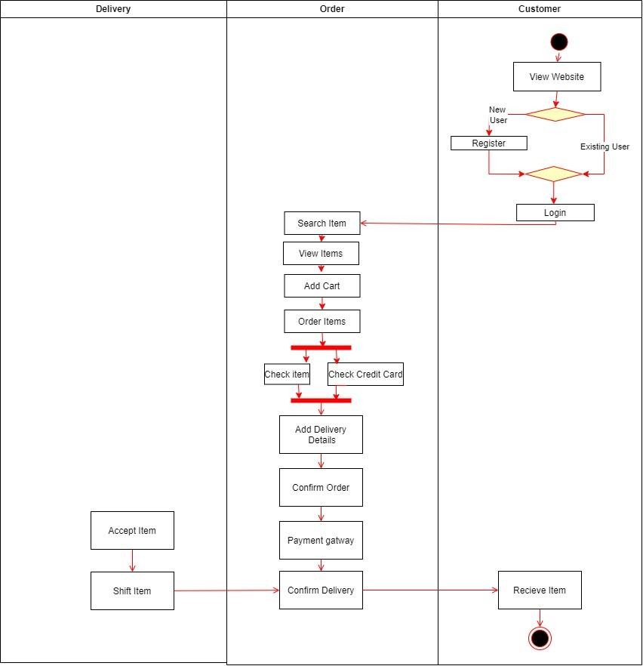
Activity Diagram:

Slide 21
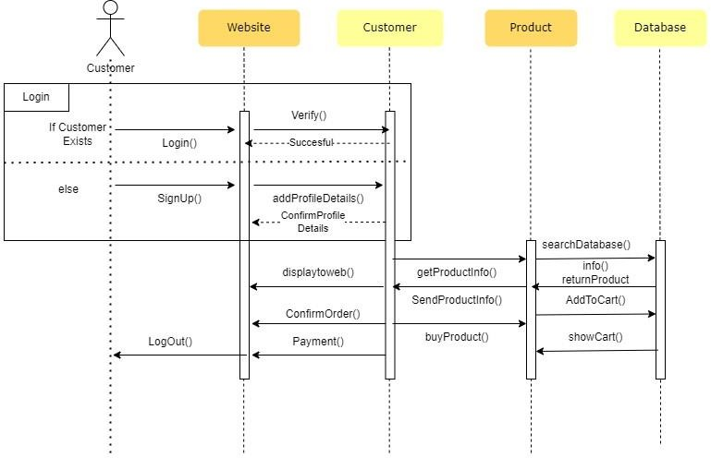
Sequence Diagram:

Slide 22
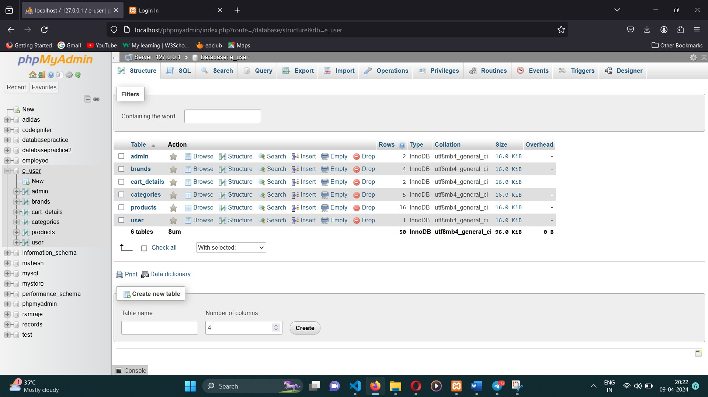
DATABASE DESIGN

Slide 23
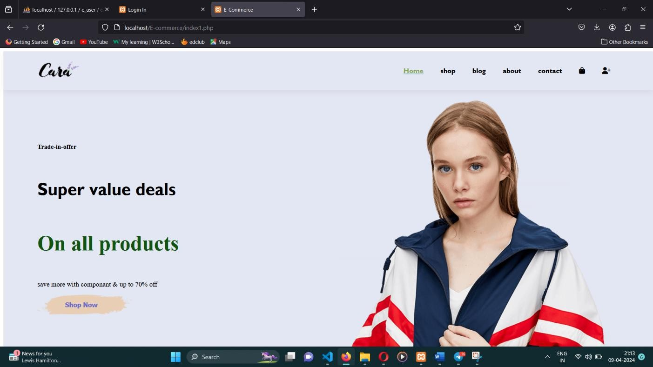
DESGIN AND IMPLEMENTATION OF E-COMMERCE WEBSITE
HOME PAGE:

Slide 24
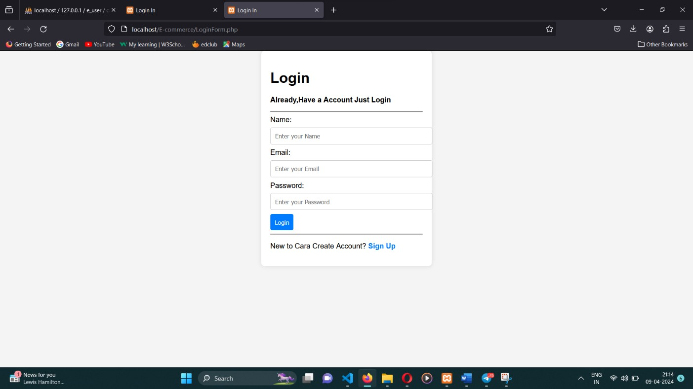
User LOG IN :
If user do not registered yet, they need to sign in and validate, register the user . It info such as Name, Phone , Email, Password , picture,etc.

Slide 25
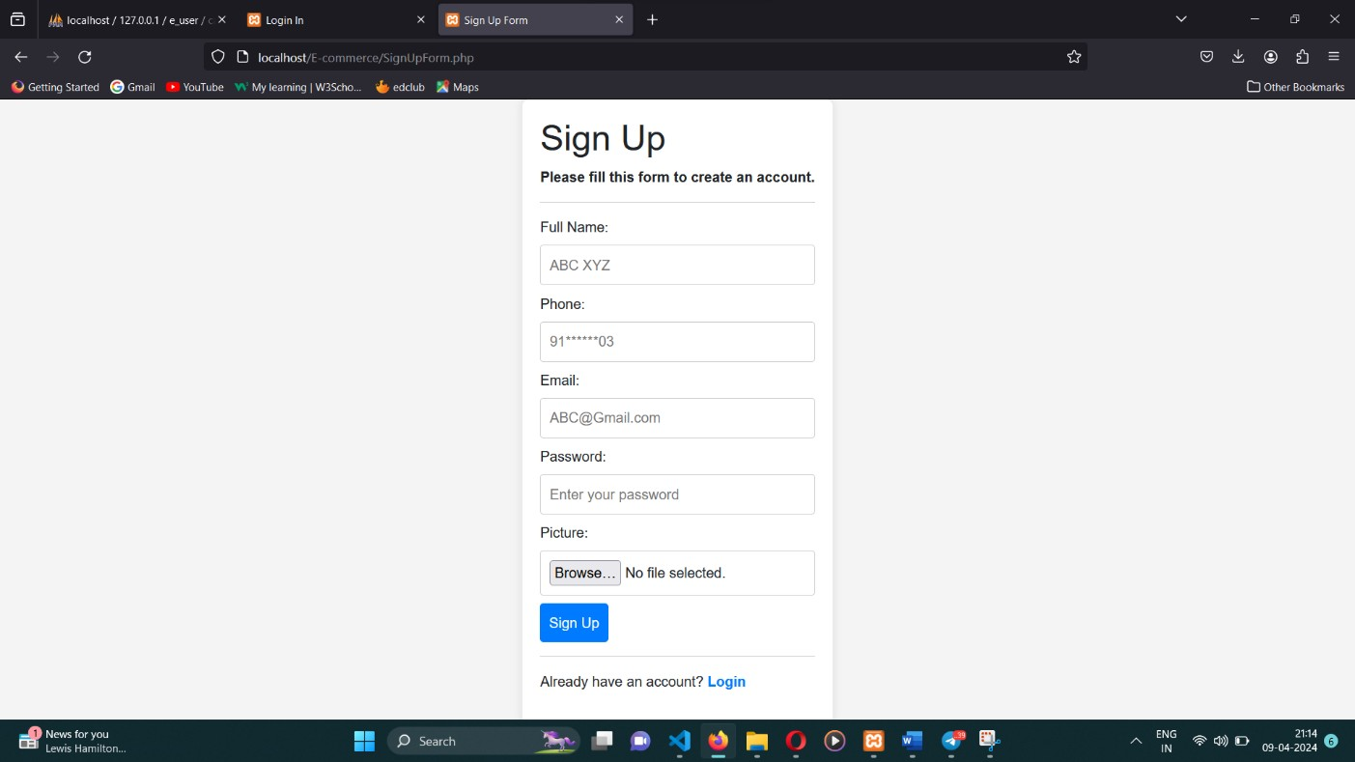
User SIGN IN :

Slide 26
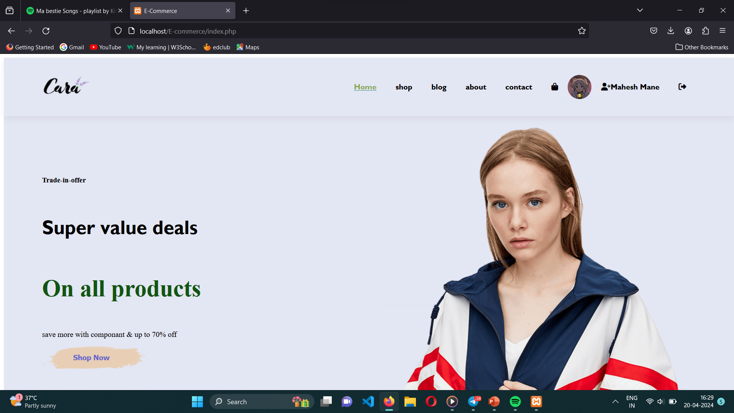
Logged Use Interface:

Slide 27
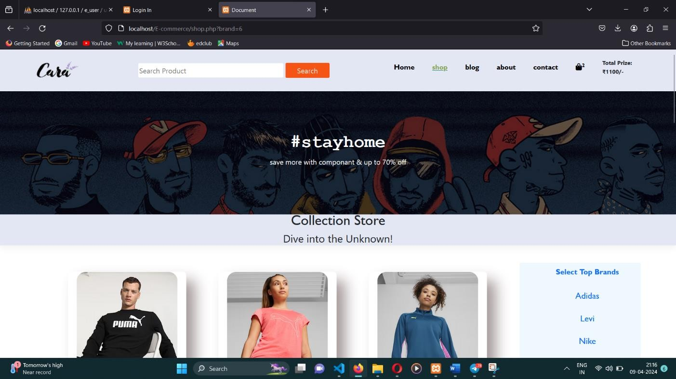
Shop Section Interface:

Slide 28
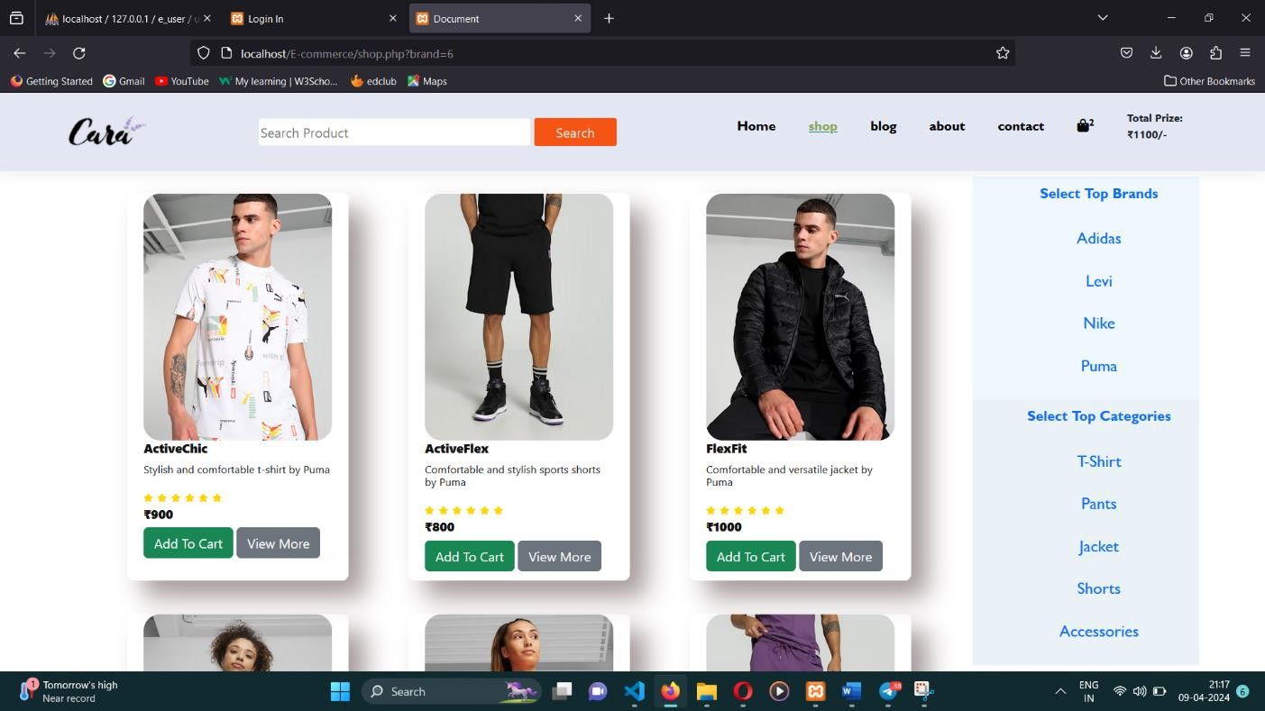
Browsing Products based on Brands & Categories :

Slide 29
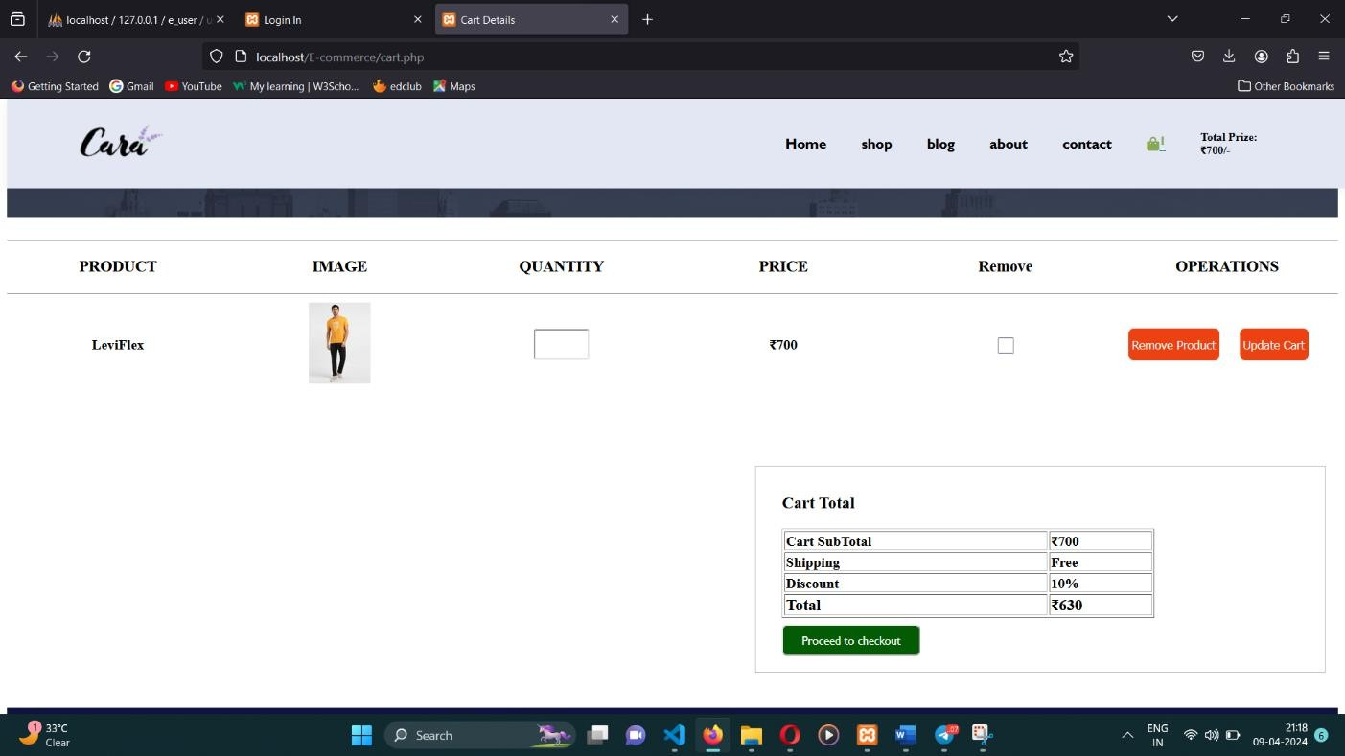
Cart Section :

Slide 30
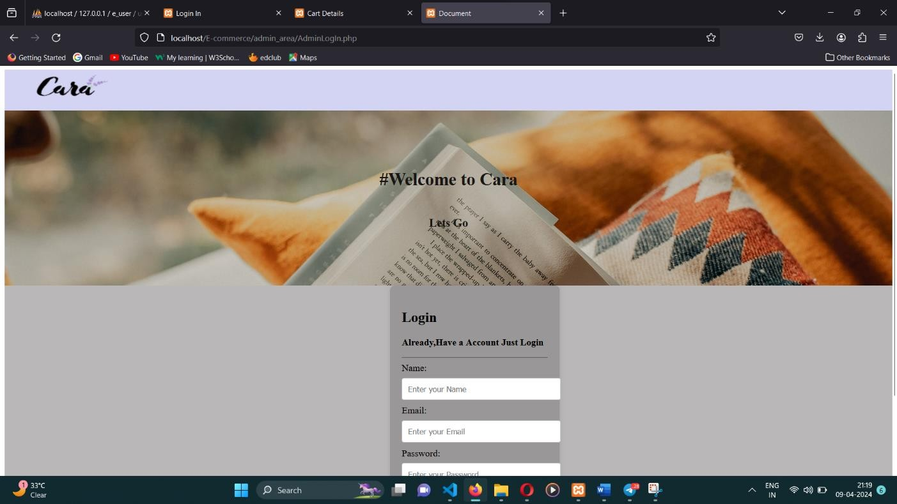
Admin LOG IN :

Slide 31
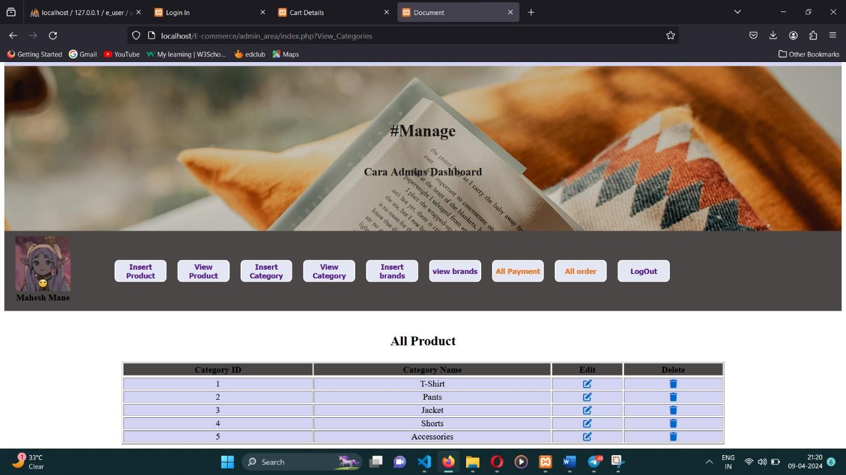
Admin Dashboard :

Slide 32
Future Scope:
Personalized Recommendations
Virtual Try-On Experience
Expanded Shopping Channels
Sustainable Practices
Enhanced Security with Blockchain
Global Market Expansion

Slide 33
Conclusion:
Our e-commerce website revolutionizes clothing shopping with intuitive navigation, personalized recommendations, and seamless transactions, ensuring a delightful user experience. With a focus on convenience, style, and security, we aim to redefine online fashion retailing for a global audience.

Slide 34
References:
Tech 2 Etc (Guide us for Frontend of the System) https://youtube.com/@Tech2etc?si=B1rx2Subql4U3lZ8
Step by Step (Guided us for Backend and functionality of the system) https://youtube.com/@KhanamCoding?si=yFjb7MQD1LvyAKsZ
Thapa Technical (Guided us for use of Xampp and learning about CRUD operations)
https://youtube.com/@ThapaTechnical?si=nFoaeT-okb1ZBKgQ
AI's lead the way which really helped
https://chat.openai.com
https://claude.ai/

Slide 35
...Thank you...

